Slide 1
Identifying Proper Location for Restaurants

Slide 2
Introduction
Factors affecting setting up a new eatery business
Location.
Food quality.
Pricing.
Customer Service.

Slide 3
Location
We understand that location is one of the foremost deciding point for success of any business.
The below factors will be considered in deciding proper location for setting up a restaurant :-
Population density.
Average Income.
Transit Commuting %.

Slide 4
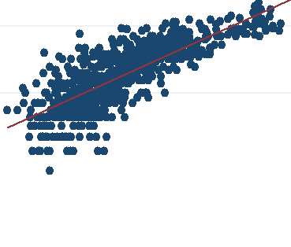
Population density
It is observed that greater is the population density higher is the number of eateries – cafe, restaurants, pizza huts etc in the surrounding areas.

Slide 5
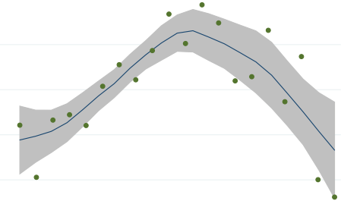
Average Income
We observe that initially with increasing average income the number of eateries-restaurants have increased but then begin to decrease beyond 50000 for Toronto.

Slide 6
Transit Commuting %
Our assumption was that more the transit % more will be the people around which will lead to more business for restaurants.
But we couldn’t establish direct connection between the two and this point needs further analysis.

Slide 7
Conclusion
Basically we see that for eatery business we need to look for location with high population density and average income .
Cluster 3 looks to be safest option in our case study.

Slide 8
Future directions
Population density based on age range has to analyzed to see if particular age group impacts the restaurant business more than others.
Grouping the location into residential, official and commercial spaces to check the impact on eatery business.

Slide 9
Data Sources
Wiki page https://en.wikipedia.org/wiki/List_of_postal_codes_of_Canada:_M for getting Toronto and neighbourhood info.
Page http://cocl.us/Geospatial_data for getting latitude/longitudes based on postal codes.
Demographic details from https://en.wikipedia.org/wiki/Demographics_of_Toronto_neighbourhoods.
Foursquare API for exploring neighbourhoods

